Slide 1
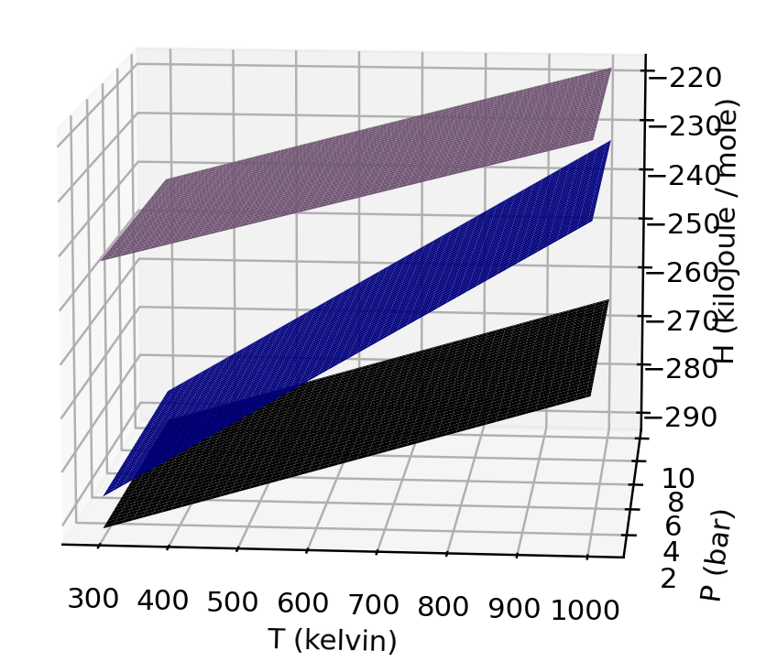
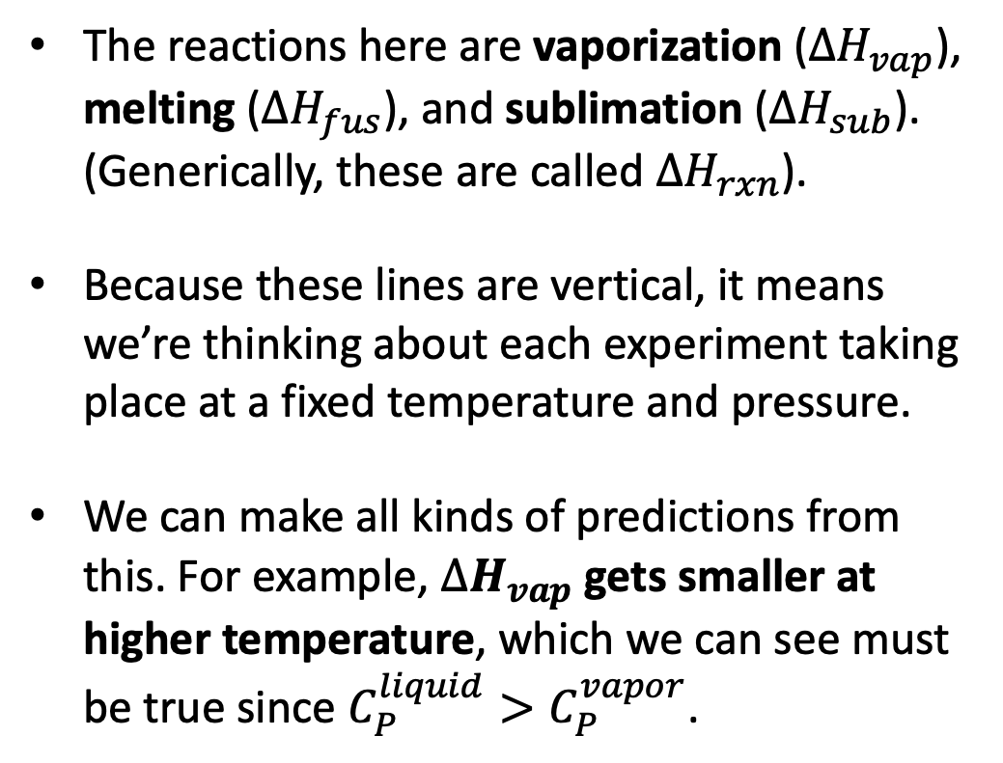



Next we’ll consider the enthalpy of reactions
The reactions here are vaporization ($∆H_{vap}$), melting ($∆H_{fus}$), and sublimation ($∆H_{sub}$). (Generically, these are called $∆H_{rxn}$).
Because these lines are vertical, it means we’re thinking about each experiment taking place at a fixed temperature and pressure.
We can make all kinds of predictions from this. For example, $∆H_{vap}$ gets smaller at higher temperature, which we can see must be true since $C_{P}^{liquid}>C_{P}^{vapor}$.
gas
$$∆H_{vap}$$
liquid
solid
$$∆H_{fus}$$
$$∆H_{sub}$$

Slide 2
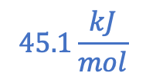
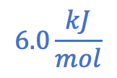
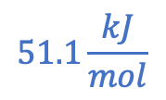
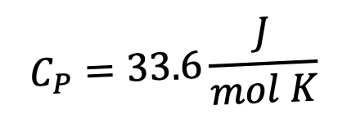

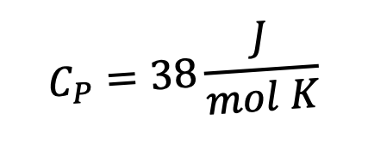



Expectations for $∆H_{rxn}$ at different temperatures
$$C_{P}=33.6\frac{J}{mol K}$$
$$ΔH_{vap}$$
H
$$C_{P}=75.4\frac{J}{mol K}$$
$$ΔH_{sub}$$
$$45.1\frac{kJ}{mol}$$
$$51.1\frac{kJ}{mol}$$
$$ΔH_{fus}$$
$$C_{P}=38\frac{J}{mol K}$$
$$6.0\frac{kJ}{mol}$$
273 K
T

Slide 3
Expectations for $∆H_{rxn}$ at different temperatures
$$C_{P}=33.6\frac{J}{mol K}$$
$$ΔH_{vap}$$
H
$$C_{P}=75.4\frac{J}{mol K}$$
$$ΔH_{sub}$$
$$45.1\frac{kJ}{mol}$$
$$51.1\frac{kJ}{mol}$$
$$ΔH_{fus}$$
$$C_{P}=38\frac{J}{mol K}$$
$$6.0\frac{kJ}{mol}$$
273 K
T
At a given temperature and pressure, the enthalpy of sublimation equals the sum of the other two (but that is obviously not true if the three are taken at different temperatures or pressures)

Slide 4

Expectations for $∆H_{rxn}$ at different temperatures
$$C_{P}=33.6\frac{J}{mol K}$$
H
$$C_{P}=75.4\frac{J}{mol K}$$
$$ΔH_{fus}$$
$$C_{P}=38\frac{J}{mol K}$$
$$6.0\frac{kJ}{mol}$$
273 K
T
What happens to $ΔH_{fus}$ at a lower temperature (like in the Arctic Ocean)?

Slide 5
Expectations for $∆H_{rxn}$ at different temperatures
$$C_{P}=33.6\frac{J}{mol K}$$
H
$$C_{P}=75.4\frac{J}{mol K}$$
$$ΔH_{sub}$$
$$C_{P}=38\frac{J}{mol K}$$
273 K
T
What happens to $ΔH_{sub}$ at a (much) lower temperature (like on Mars!)?

Slide 6
Expectations for $∆H_{rxn}$ at different temperatures
$$C_{P}=33.6\frac{J}{mol K}$$
$$ΔH_{vap}$$
H
$$C_{P}=75.4\frac{J}{mol K}$$
$$C_{P}=38\frac{J}{mol K}$$
273 K
T
For $ΔH_{vap}$, when the temperature gets high enough, we can figure $ΔH_{vap}→0$, right?

Slide 7
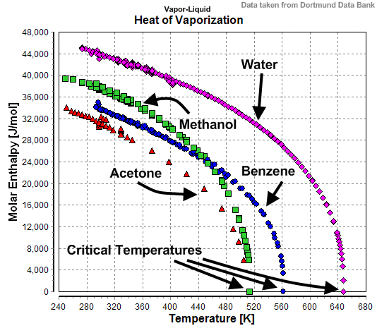

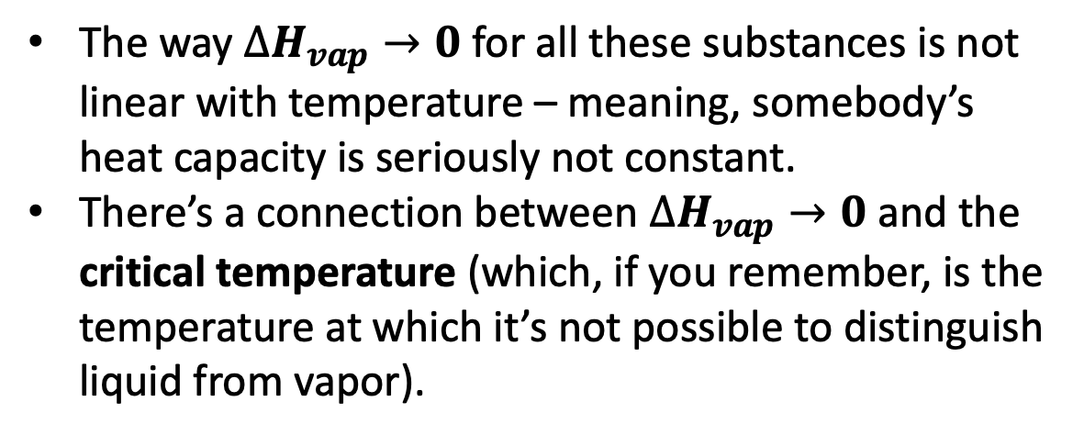
Some interesting behaviors in the approach to the critical temperature
The way $∆H_{vap}→0$ for all these substances is not linear with temperature – meaning, somebody’s heat capacity is seriously not constant.
There’s a connection between $∆H_{vap}→0$ and the critical temperature (which, if you remember, is the temperature at which it’s not possible to distinguish liquid from vapor).
=> This is a matter of ongoing research, both theoretical and experimental

Slide 8
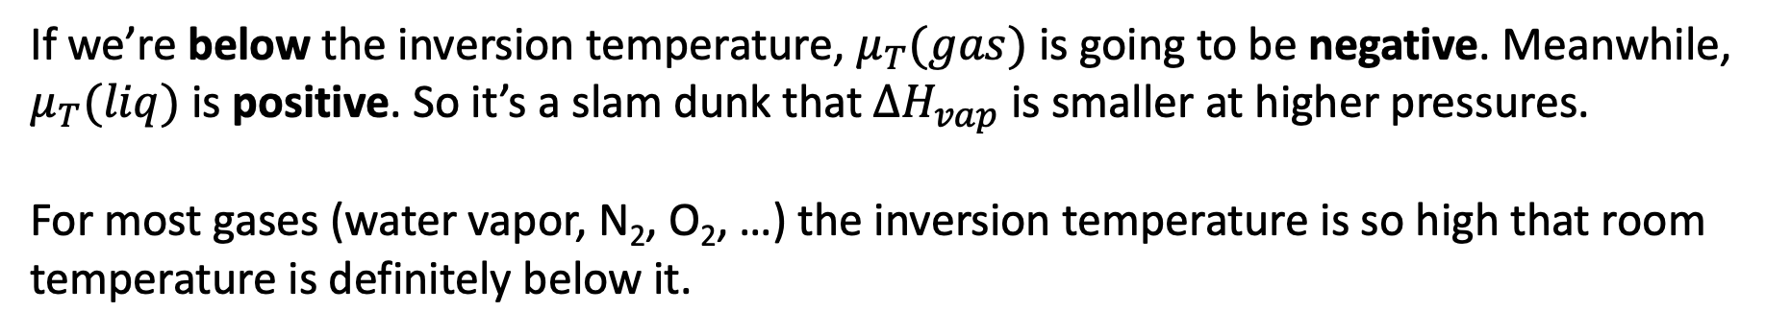
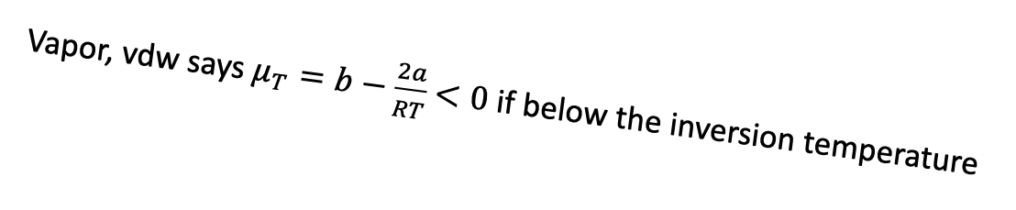
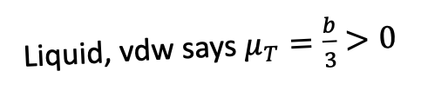
Expectations for $∆H_{rxn}$ at different pressures
Vapor, vdw says $μ_{T}=b−\frac{2a}{RT}$ $<0$ if below the inversion temperature
Liquid, vdw says $μ_{T}=\frac{b}{3}$ $>0$
B
A
P -->
B
A
If we’re below the inversion temperature, $μ_{T}(gas)$ is going to be negative. Meanwhile, $μ_{T}(liq)$ is positive. So it’s a slam dunk that $ΔH_{vap}$ is smaller at higher pressures.
For most gases (water vapor, N₂, O₂, …) the inversion temperature is so high that room temperature is definitely below it.

Slide 9
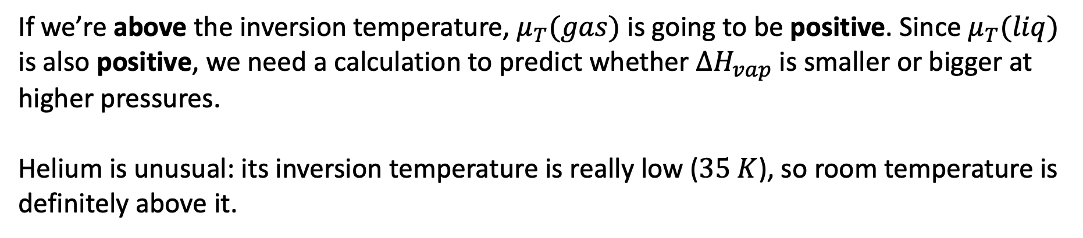
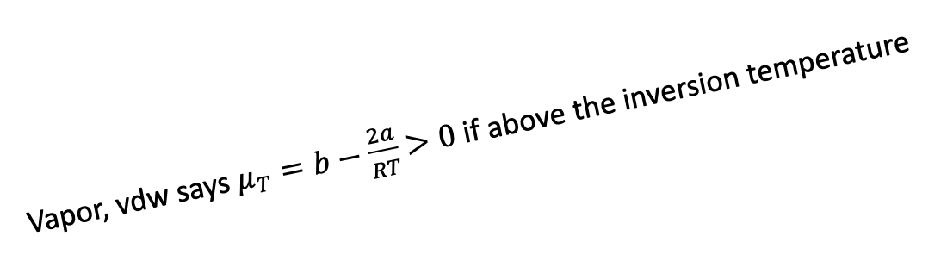
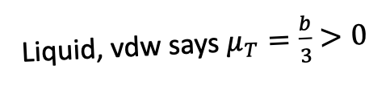
Expectations for $∆H_{rxn}$ at different pressures
Vapor, vdw says $μ_{T}=b−\frac{2a}{RT}$ $>0$ if above the inversion temperature
Liquid, vdw says $μ_{T}=\frac{b}{3}$ $>0$
B
A
P -->
B
A
If we’re above the inversion temperature, $μ_{T}(gas)$ is going to be positive. Since $μ_{T}(liq)$ is also positive, we need a calculation to predict whether $ΔH_{vap}$ is smaller or bigger at higher pressures.
Helium is unusual: its inversion temperature is really low ($35 K$), so room temperature is definitely above it.

Slide 10

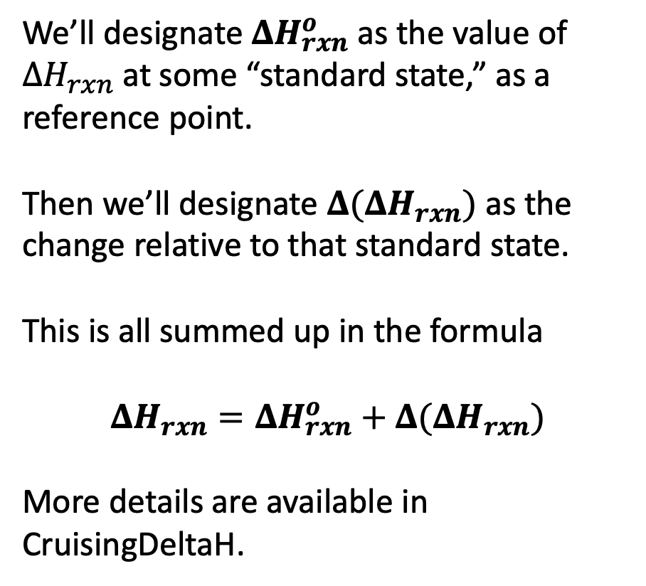

Defining a reference point, and $Δ(ΔH_{rxn})$
We’ll designate $ΔH_{rxn}^{o}$ as the value of ${ΔH}_{rxn}$at some “standard state,” as a reference point.
Then we’ll designate $Δ(ΔH_{rxn})$ as the change relative to that standard state.
This is all summed up in the formula
$$ΔH_{rxn}=ΔH_{rxn}^{o}+Δ(ΔH_{rxn})$$
More details are available in CruisingDeltaH.
gas
liquid
$$ΔH_{vap}$$
$$ΔH_{vap}^{o}$$
solid

Slide 11
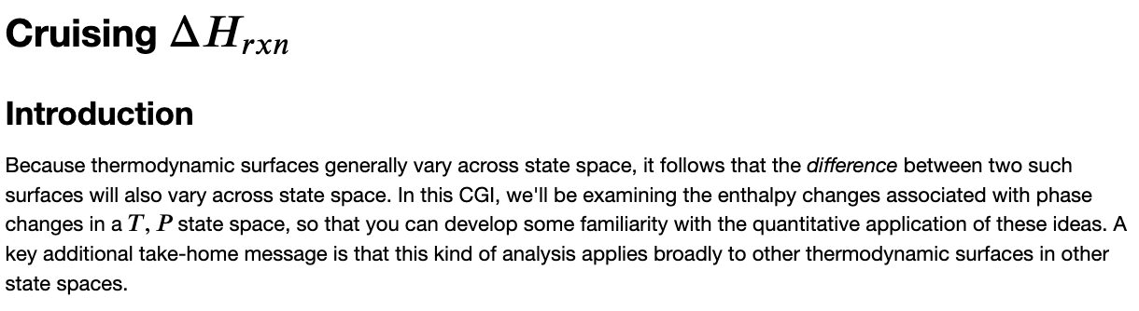
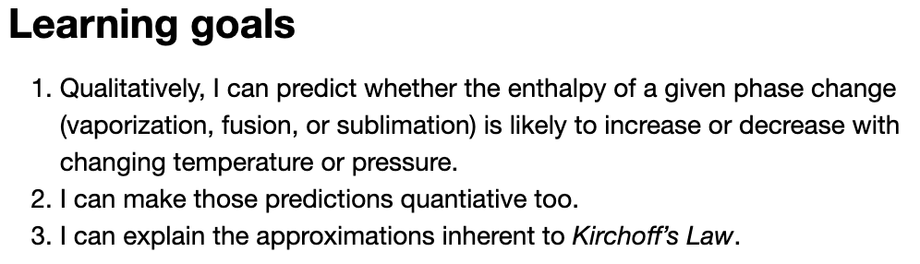
We’ll be exploring this in Cruising $∆H_{rxn}$

